Slide 1
SparkML Object Inheritance Hierarchy
Feature Prep
Classes from spark.ml.feature.* which prepare features. Classes that need to look at the whole dataset, like One Hot Encoding, need to be fit into Models. Classes like Bucketizer follow simple rules and inherit directly from Transformer.
Transformer
Transformers create new DataFrames using the transform API, which applies algorithms to the input DataFrame and outputs a DataFrame with additional columns.
some
classes
some classes
fit
(against
DataFrame)
inherits from
Estimator
Estimators create Models of data using the fit method.
Model
inherits from
inherits from
Predictor
A special type of Estimator for predictive models (Regression and Classification). These require a label column when fitting.
PredictionModel
PredictionModels include Regression and Classification models. These have a label column and most support the predict API.
Training
Predictions

Slide 2
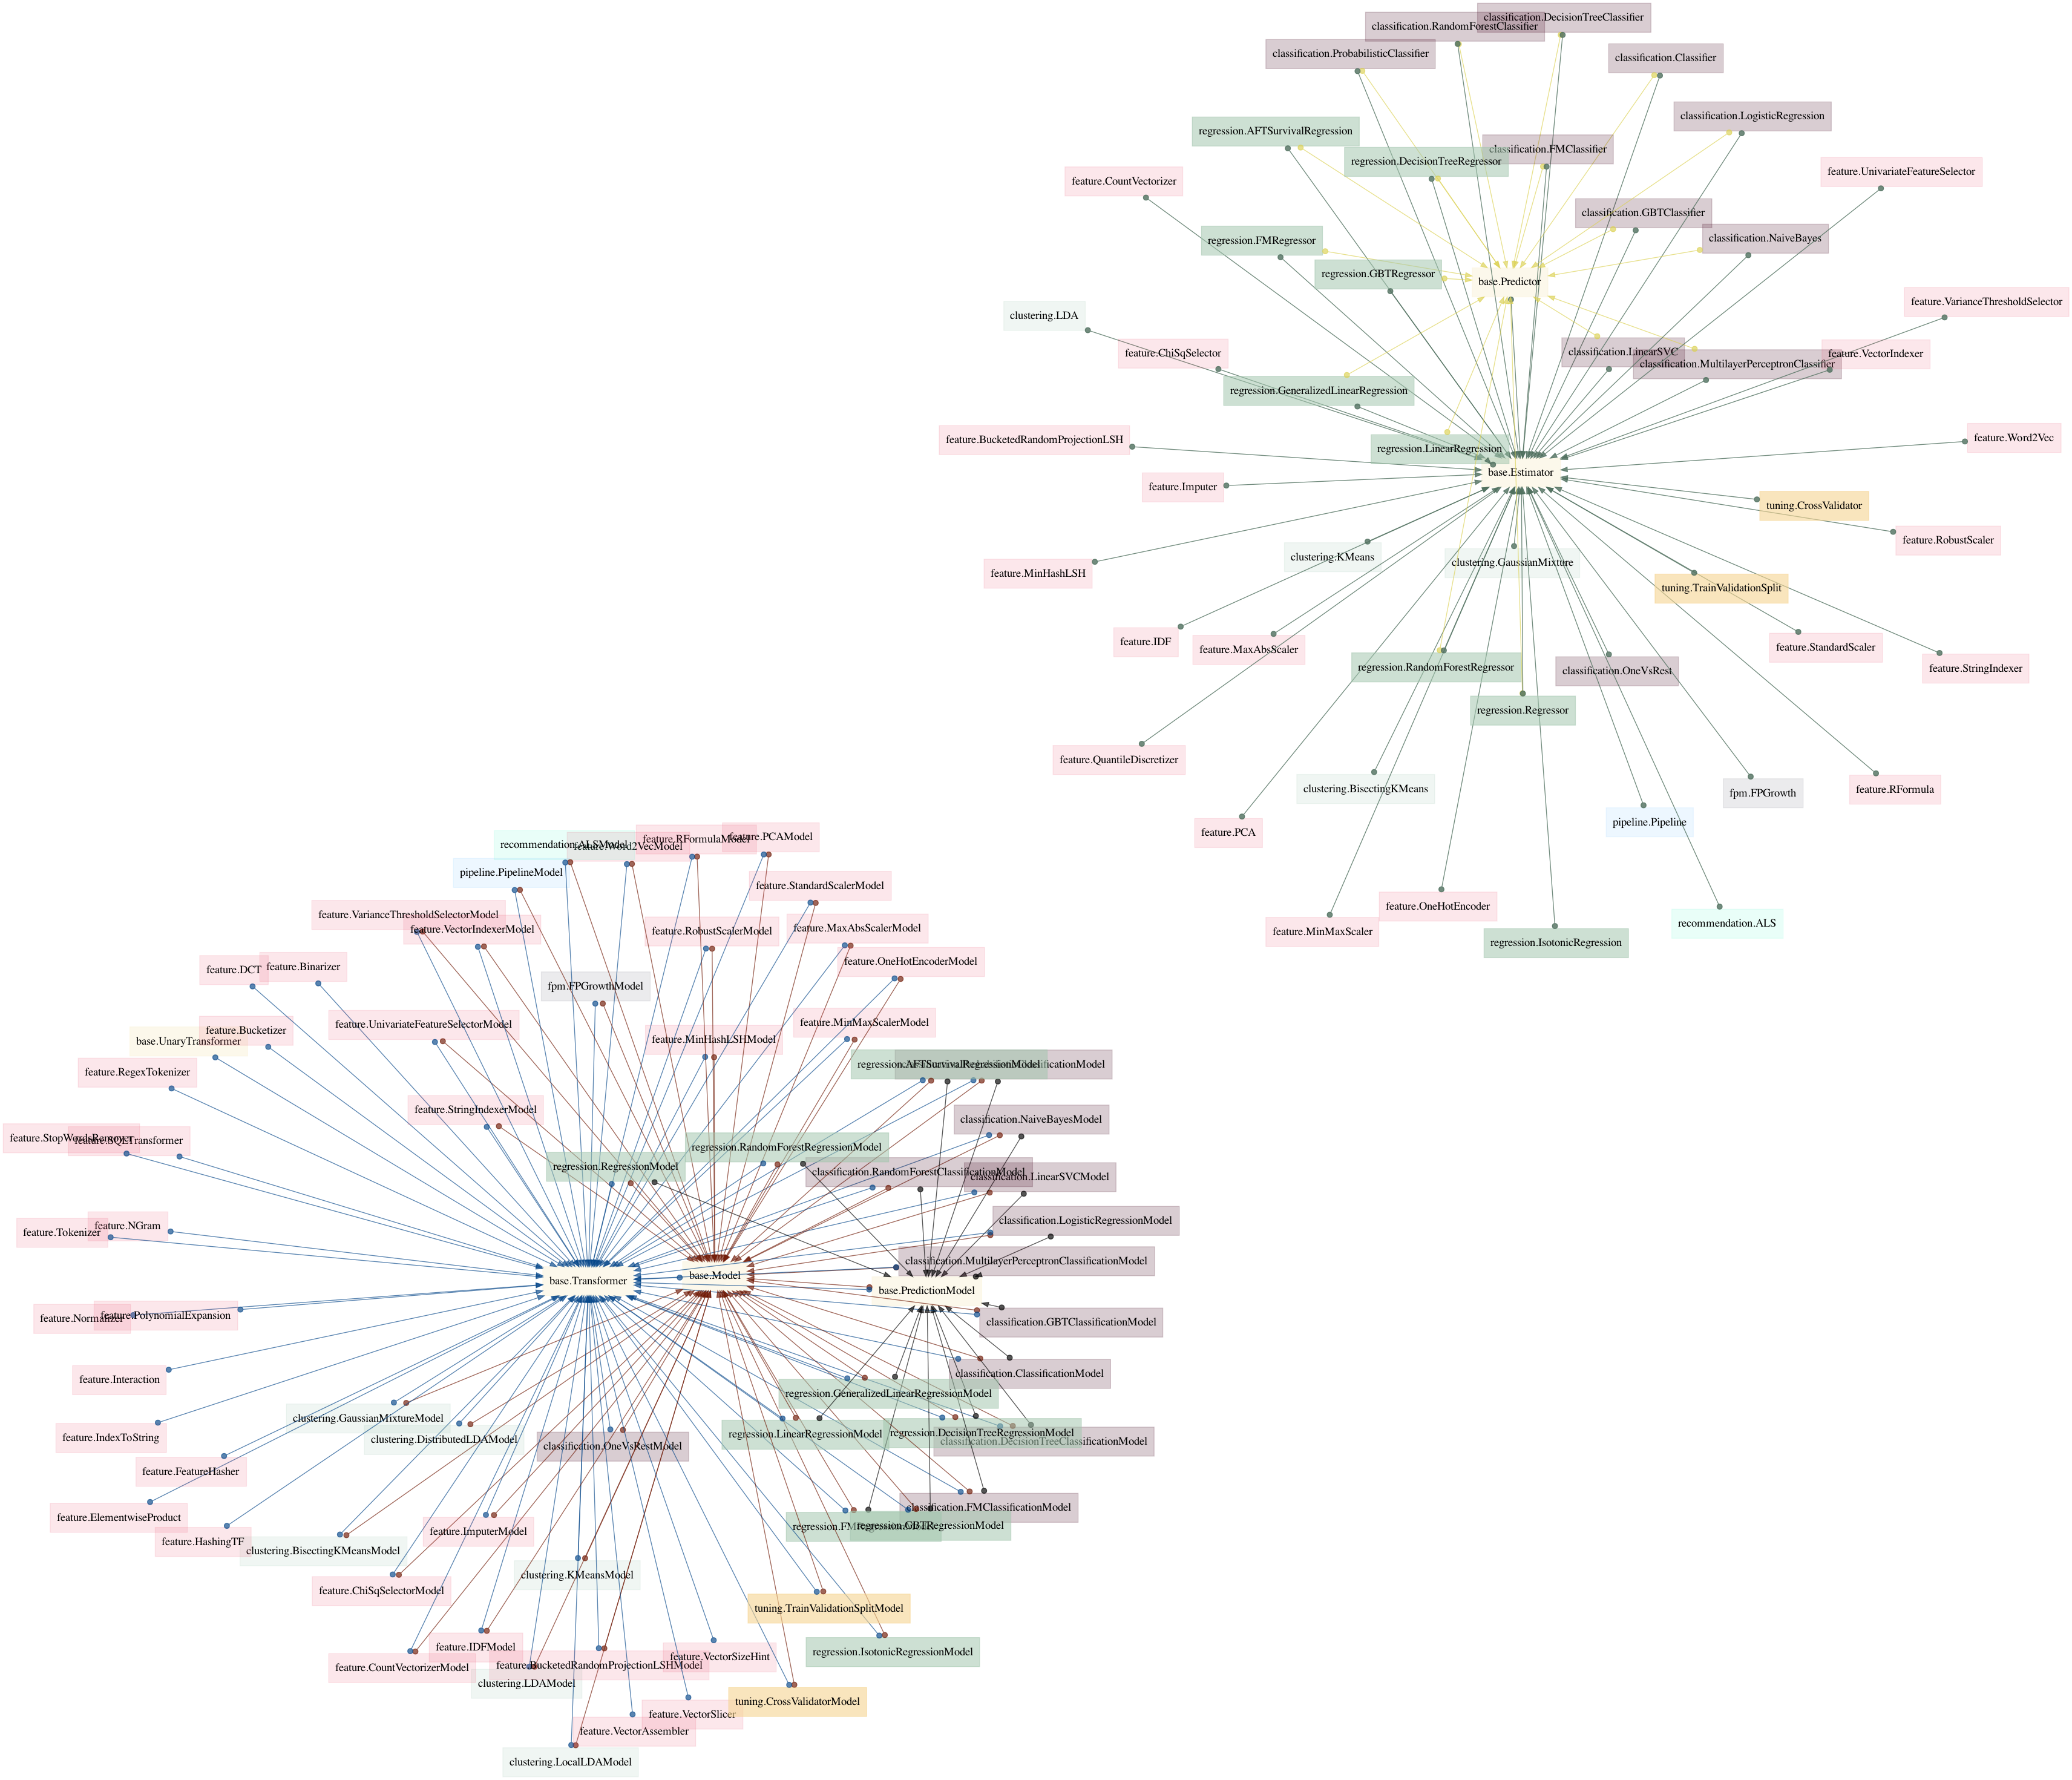
Estimators
Class Mapping
MLlib
Spark 3.2.1
Transformers and Models

Slide 3
ml_linear_regression
A Simple ML Model Pipeline
VectorAssembler
transform
Estimator
fit
Model
Raw Data
featuresCol (vector)
labelCol (predictors only)
Raw DataFrame
Prepared DataFrame
other columns
featuresCol
(vectors)
labelCol

Slide 4
ml_hyperparameter_tuning
Optimize Parameter Selection using a CrossValidator
Estimator: pyspark.ml.tuning.CrossValidator
CrossValidator
fit
VectorAssembler
fit/transform
(not called directly)
Estimator
fit/transform
(not called directly)
Raw Data
featuresCol (vector)
labelCol (predictors only)
fit
CrossValidatorModel
Raw DataFrame
Prepared DataFrame
bestModel
returns the best Model
other columns
featuresCol
(vectors)
labelCol

Slide 5
A Simple End-to-End ML Pipeline
Estimator: pyspark.ml.Pipeline
spark.ml.feature.*
fit / transform
(not called directly)
spark.ml.feature.*
fit / transform
(not called directly)
Pipeline
fit
PipeLineModel
inputCol
outputCol
featuresCol (vector)
labelCol (predictors only)
Raw DataFrame
Intermediate
Prepared DataFrame
Phase 1: Data Preparation
other columns
featuresCol
(vectors)
labelCol
PipeLineModel
transform
Transformed DataFrame
Raw Data
Estimator: pyspark.ml.tuning.CrossValidator
CrossValidator
fit
Estimator
fit
(not called directly)
Prepared DataFrame
fit
Phase 2: Model Fitting and Selection
CrossValidatorModel
other columns
featuresCol
(vectors)
labelCol
bestModel
returns the best PipelineModel

Slide 6
A Simple Complete ML System
Estimator: pyspark.ml.Pipeline
spark.ml.feature.*
fit / transform
(not called directly)
spark.ml.feature.*
fit / transform
(not called directly)
Pipeline
fit
PipeLineModel
inputCol
outputCol
featuresCol (vector)
labelCol (predictors only)
Phase 1: Data Preparation
Raw DataFrame
Intermediate
Prepared DataFrame
other columns
featuresCol
(vectors)
labelCol
PipeLineModel
transform
Transformed DataFrame
versioned
read
Raw Data
save
Feature Store
Online Serving Infrastructure
versioned read
Estimator: pyspark.ml.tuning.CrossValidator
CrossValidator
fit
Estimator
fit
(not called directly)
Prepared DataFrame
fit
predict
CrossValidatorModel
Phase 2: Model Fitting and Selection
other columns
featuresCol
(vectors)
labelCol
bestModel
returns the best Model
save /
track
MLFlow

Slide 7
Join Types in Spark
match
match
left
right
inner join
left
right
full (outer) join
no match
no output
no match
match
match
left
right
left (outer) join
left
right
left semi join
no match
no match
no output
match
match
no output
left
right
right (outer) join
left
right
left anti join
no match
no match
cross join
r1
r1
 | left columns
 | right columns
 | nulls only
left
right
r1
r2
r1
r3
r2
r1
r2
r2
r2
r3

